Slide 1

Data Analyst Capstone Project
by Yuliia Kononchuk
March 2025

Slide 2



OUTLINE
Executive Summary
Introduction
Methodology
Results
Visualization – Charts
Discussion
Findings & Implications
Conclusion
Appendix

Slide 3

EXECUTIVE SUMMARY
The aim of this presentation is to summarize future skills requirements and trends in the IT sector to help the company to keep pace with changing technologies and make more informed hiring and developing decisions, remain competitive in the fast-evolving industry.
This analysis is based on data from various sources including: job postings, blog posts and surveys. Collected data were prepared for analysis by using data wrangling methods, then statistical techniques were applied to identify insights and trends:
Top programming languages, database skills, platforms in demand
Trends for languages, databases, platforms for the next year
Demographic data like gender and age distribution of developers, education, level of compensation, their median values, distribution and comparison.

Slide 4

INTRODUCTION
This presentation is a result of collecting and analyzing data from various sources, such as job postings on Naukri, IBM training’s dataset, survey about popular languages and salaries in the industry. The most significant amount of data came from the Stack Overflow’s annual Developer Survey 2019.
The actual data set of the survey has around 90,000 responses. In this analysis a subset, that contains around 1/10th of the original data set (N = 11 398), was examined.
This report is relevant for educators, students, developers, recruiters, HR specialists to understand the trends and skills requirement in the IT industry.

Slide 5

METHODOLOGY
• Data Sources:
Stack Overflow Survey 2019
Github Job Posting
Programming Language Annual Salary
• Data Exploration and Cleaning
- Python
• Data Visualization
- IBM CognosAnalytics
• Presentation

Slide 6
RESULTS
Dataset before cleaning rows - 11552, columns – 85, duplicate rows – 154, after removing N= 11398.
Median age of the respondents – 29 years and 75 % of them are under 35. Min and max ages are 16 and 99 years. The age group of 24-32 years has the highest number of survey respondents.
Majority of respondents are male 93.5 % vs 6.5% - female.
Educational level – Bachelor's degree - 51.8%, Master’s degree-23.9%.
Of professional developers who studied at the university level, over 60% engineering, or software engineering.
96 % are employed full-time and 4% - are part-time.
90 % of the respondents are developers by profession and 10% are not primarily developers, but write code from time to time database administrators, data or business analysts, data scientists or machine learning specialists, designers, system administrators, engineers (, researchers).
Median salary in the industry after removing outliers: $52,704 per year. mean compensation – $34,567.
Distribution of salaries depending on the coding language (last slide): maximum - Swift (for IOS development), then Python, C++, JavaScript.
Job postings demonstrate the demand for specialists, regarding their skills - most wanted are with a qualification in
Converted compensation has the biggest correlation with age – which means older (often more qualified, with higher job positions) developers have higher compensations.

Slide 7
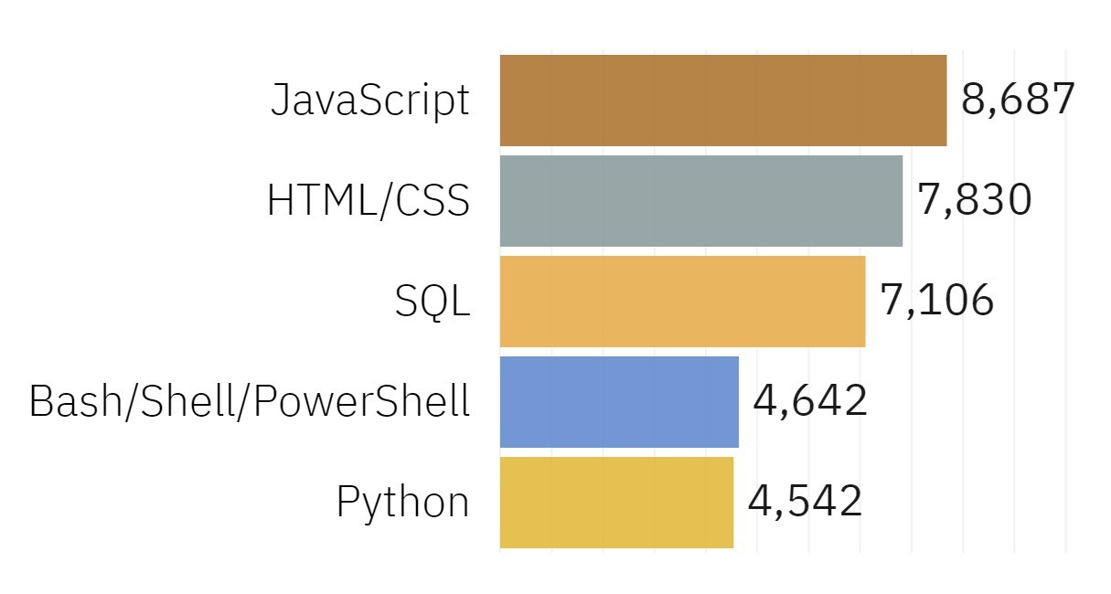
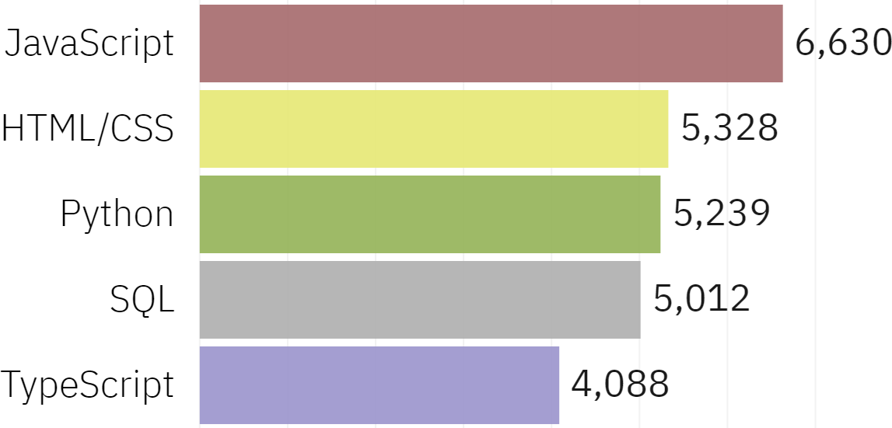
PROGRAMMING LANGUAGE TRENDS
Current Year
Next Year

Slide 8
PROGRAMMING LANGUAGE TRENDS - FINDINGS & IMPLICATIONS
Findings
• JavaScript - The most demanded programming language.
• Other- Python, HTML/CSS, and SQL
• TypeScript more desirable than Bash/Shell/PowerShell.
Implications
Python’s increase may surpass JavaScript in the future.
• Consistent demand for HTML/CSS, Java, SQL, and Python.
• High demand for Web Development

Slide 9
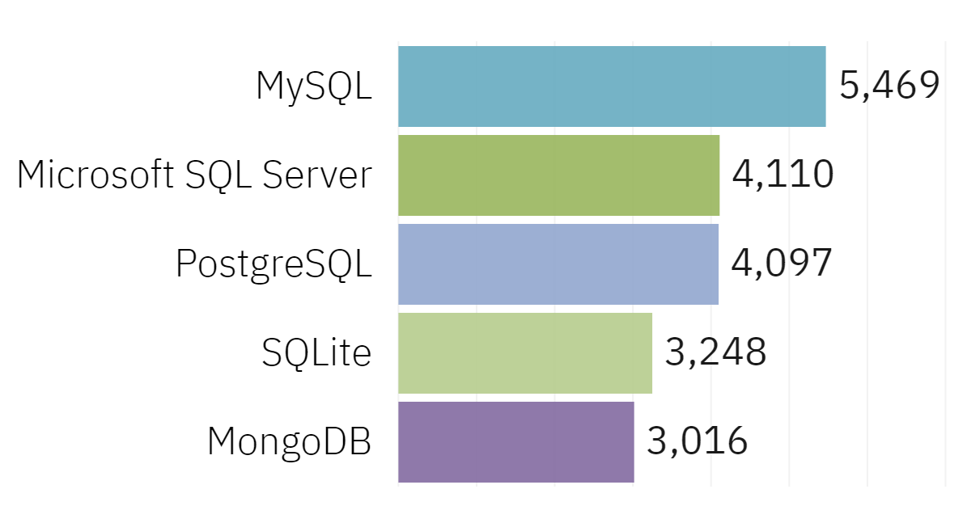
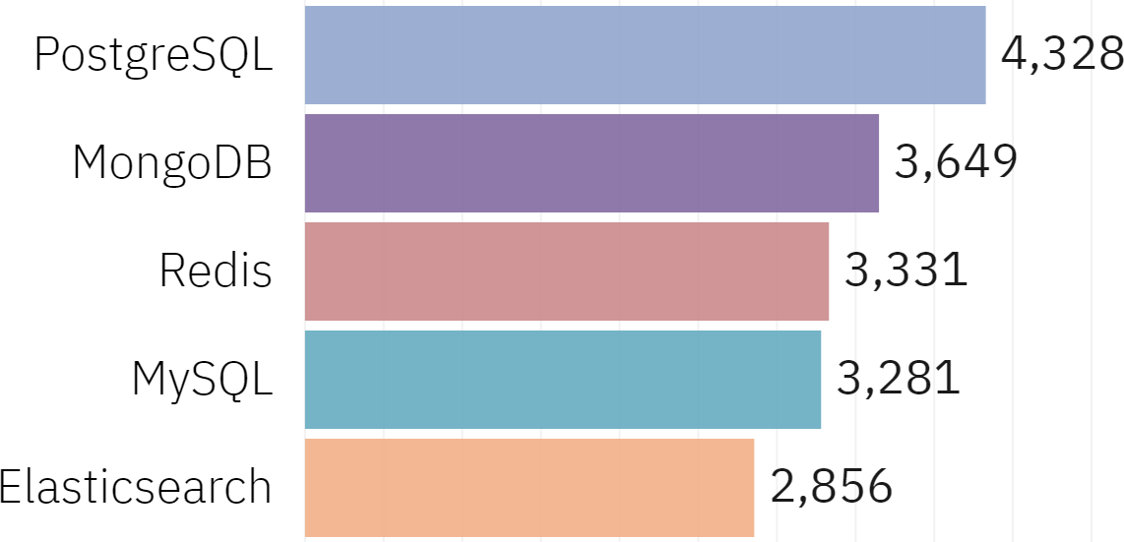
DATABASE TRENDS
Current Year
Next Year

Slide 10
DATABASE TRENDS - FINDINGS & IMPLICATIONS
Findings
Demand increase: PostgreSQL - MongoDB
Demand decrease: MySQL
Desire increase: Redis - ElasticSearch
Implications
Demand consistency: PostgreSQL - MongoDB
Preferred databases: Open Source

Slide 11
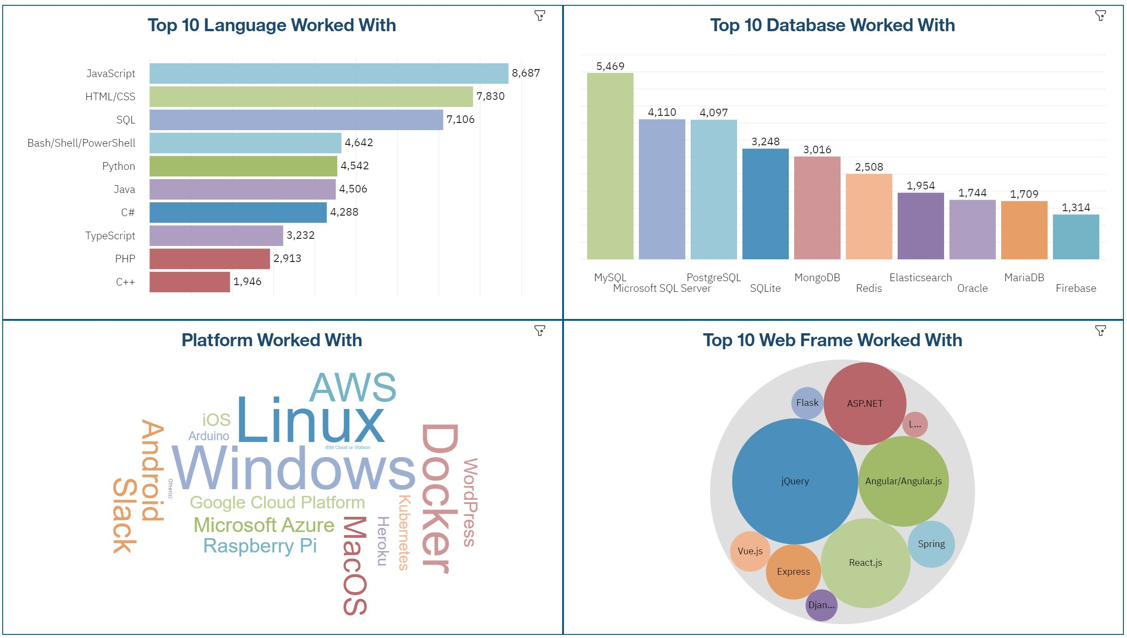
DASHBOARD TAB.1 Current Technology Usage

Slide 12
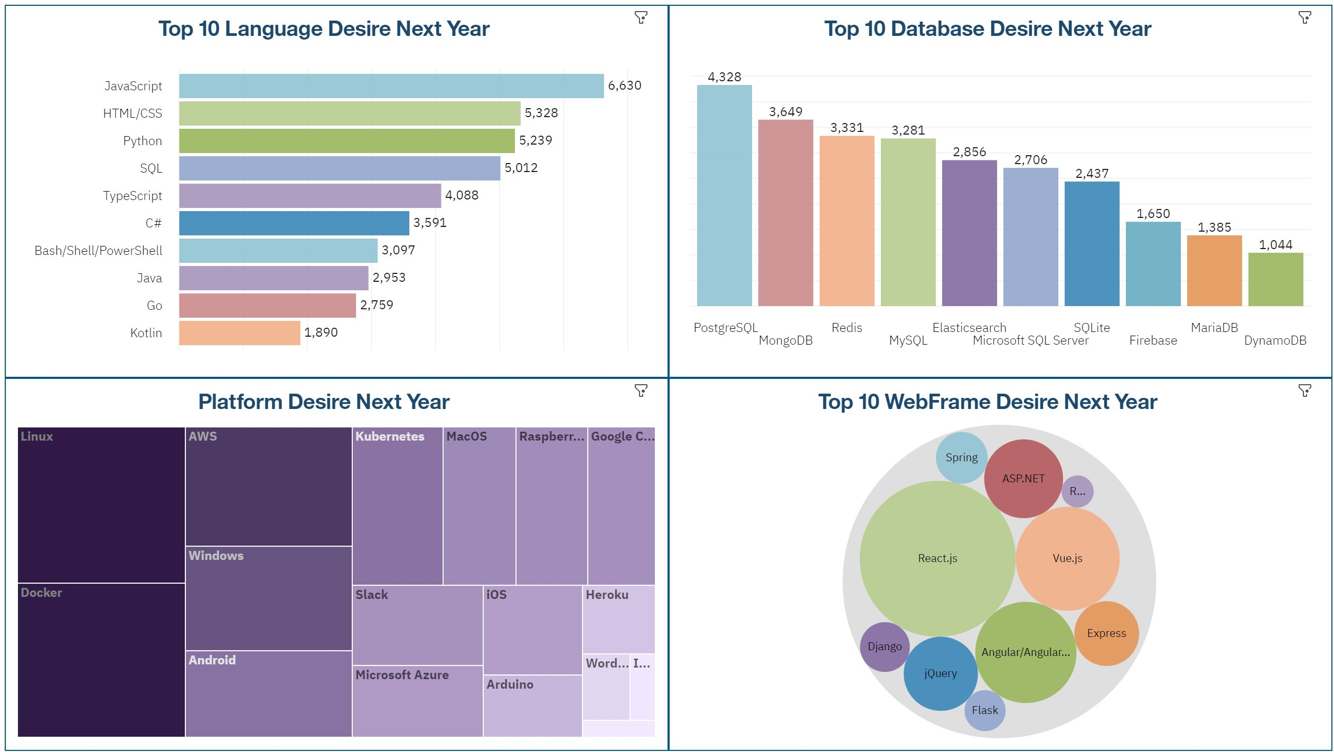
DASHBOARD TAB.2 Future Technology Trend

Slide 13
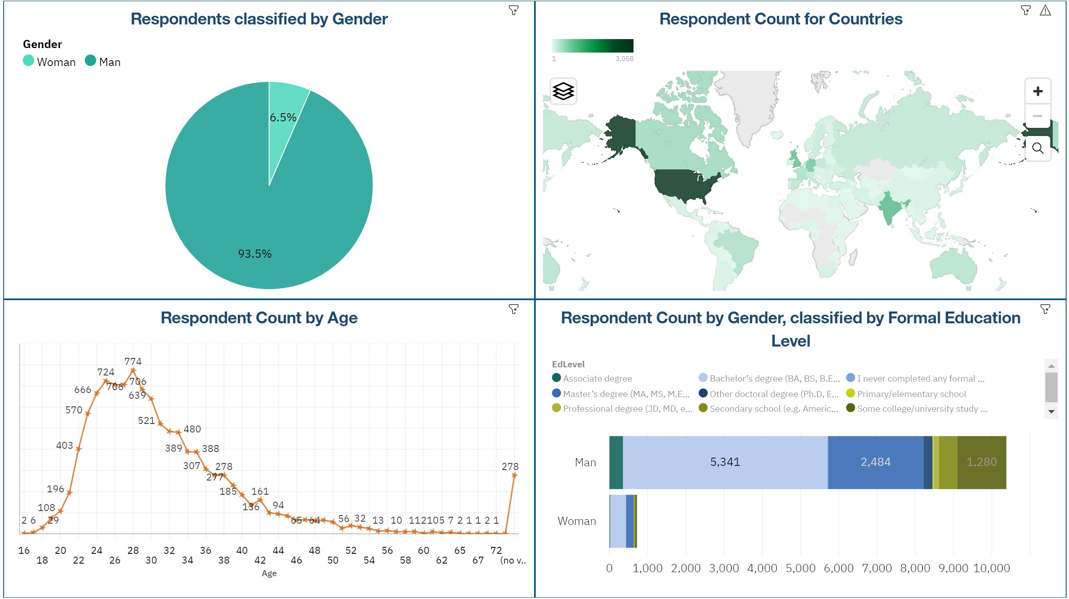
DASHBOARD TAB.3 Demographics

Slide 14

DISCUSSION
The insights and trends include the following questions:
What are the top programming languages in demand?
What are the top databases in demand?
What are the most popular developers technologies, web frames, platforms?

Slide 15
FINDINGS & IMPLICATIONS
Findings
Demands and trends can vary based on new technologies.
Popular Languages: JavaScript - Python
Popular Databases: PostgreSQL
Implications
Companies and individuals need to adapt the new demands.
Proficiency in higher demand skills can lead to more opportunities.

Slide 16

CONCLUSION
New technologies lead to varied trends and demands.
Most popular programming Languages: JavaScript - Python
Most popular database: PostgreSQL
The Information Technology field needs diversity.

